Slide 1



CAPSTONE PROJECT
An Intelligent Real-Time Crowd Dynamics Analysis and Monitoring System using Computer Vision
DSA0202-COMPUTER VISION WITH OPENCV
Presented by:
Pujitha K (192524149)
Hashini S (192524035)
Sravani B (192324203)
Hari Priya R (192524087)
GUIDE BY:
Dr. M. Mayuranathan

Slide 2


INTRODUCTION
Crowd management is a major challenge in public places such as events, transportation hubs, campuses, and other crowded environments.
Manual monitoring of large crowds is difficult, time-consuming, and prone to human error.
Overcrowding and abnormal crowd movement can create serious safety risks and may lead to accidents or emergency situations.
This project uses Computer Vision to automatically analyze live video feeds and understand crowd behavior in real time.
The system can detect and count people, estimate crowd density, track movement and speed, and analyze crowd flow direction.

Slide 3
OBJECTIVES
To develop a real-time crowd monitoring system using Computer Vision.
To detect and count individuals accurately from live video streams.
To estimate crowd density and identify overcrowded areas in real time.
To analyze the speed, movement, and flow direction of individuals within a crowd.
To identify abnormal or unusual crowd movement patterns and generate timely alerts.
To improve public safety by providing automated and intelligent crowd monitoring.

Slide 4
PROBLEM STATEMENT
Manual monitoring of large crowds is difficult, time-consuming, and inefficient.
Increasing crowd density can create overcrowding and serious safety risks.
It is difficult for human operators to continuously track every individual in a crowded environment.
Sudden changes in crowd speed, direction, or movement may indicate abnormal or potentially dangerous situations.
There is a need for an automated system that can detect people, measure crowd density, analyze movement, and identify abnormal behavior in real time.

Slide 5
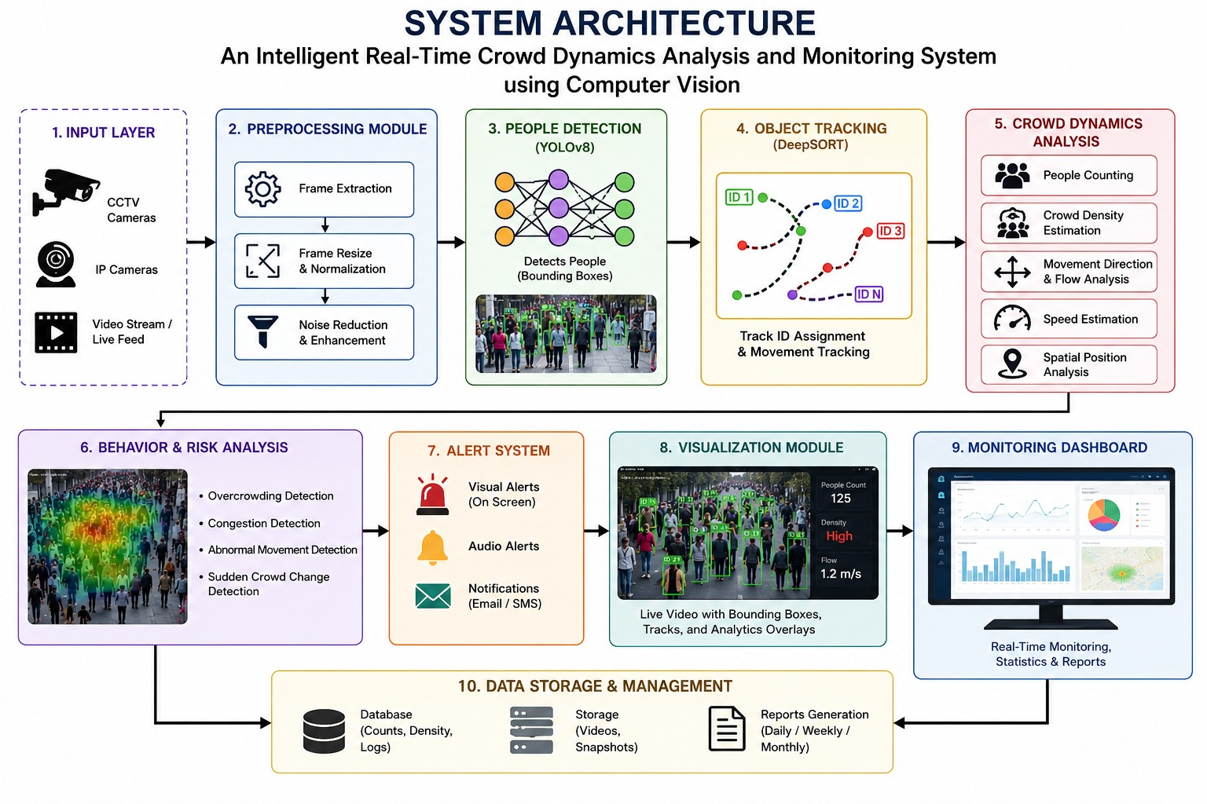

Slide 6
MODULE 1:
INTELLIGENT HUMAN DETECTION AND LOCALIZATION IN REAL-TIME VIDEO STREAMS
Overview
This module focuses on detecting and locating humans in real-time video streams.
Objective
To detect every individual present in the video frame.
To generate bounding boxes around detected persons.
To determine the spatial position of each person in the scene.
Methodology
Capture live video using CCTV or camera input.
Apply a pre-trained object detection model such as YOLO.
Extract bounding box coordinates for each detected person.
Store position data for further crowd analysis.

Slide 7
MODULE 2: VISION-BASED CROWD DENSITY MEASUREMENT IN SURVEILLANCE VIDEOS
Overview
This module focuses on estimating crowd density using surveillance video footage.
It analyzes the number of people detected in each frame to determine crowd concentration levels.
Objective
To calculate the number of people present in a given area.
To classify crowd levels as low, medium, or high density.
To identify overcrowded zones in real time.
Methodology
Use the output from the human detection module.
Count the number of detected individuals per frame.
Define density thresholds based on area size.
Generate visual indicators or alerts when density exceeds safe limits.
.

Slide 8
MODULE 3: REAL-TIME CROWD SPEED ESTIMATION AND MOTION ANALYSIS
Overview
This module analyzes the movement and speed of individuals within a crowd using real-time video streams.
It helps understand crowd flow patterns and detect unusual motion behavior.
Objective
To estimate the speed of people in the surveillance area.
To analyze crowd flow direction and movement patterns.
To identify sudden changes in motion that may indicate abnormal situations.
Methodology
Track detected individuals across consecutive video frames.
Use Optical Flow or object tracking algorithms to measure displacement.
Calculate speed based on frame difference and time interval.
Analyze motion trends to detect irregular crowd behavior.

Slide 9
MODULE 4: CROWD FLOW DIRECTION AND MOVEMENT PATTERN ANALYSIS
Overview
This module focuses on analyzing the overall direction and movement patterns of the crowd in real time.
Objective
To determine the dominant flow direction of the crowd.
To analyze movement patterns over time.
To detect unusual or conflicting movement directions.
Methodology
Track multiple individuals across consecutive frames.
Use Optical Flow or motion vector analysis to determine direction.
Visualize flow using arrows or heatmaps.
Compare current movement patterns with normal behavior patterns.

Slide 10
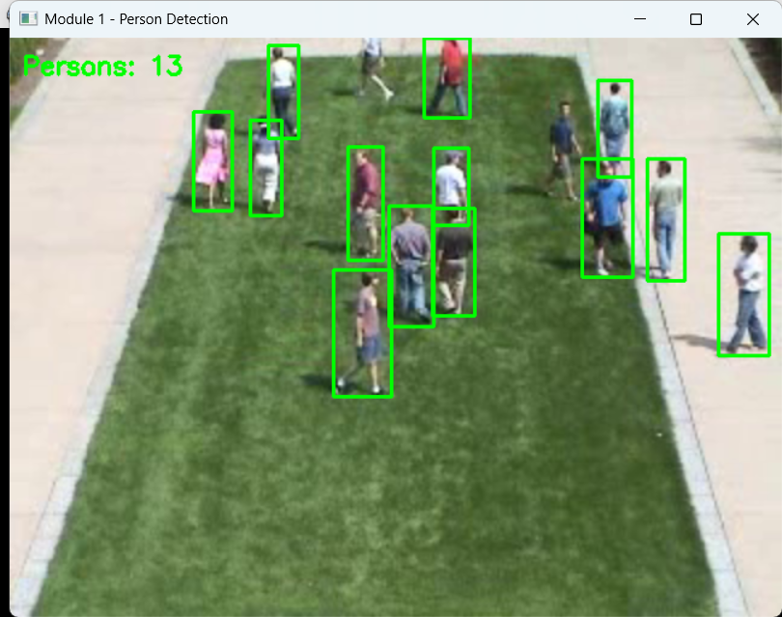
IMPLEMENTATION MODULE 1-PERSON DETECTION

Slide 11
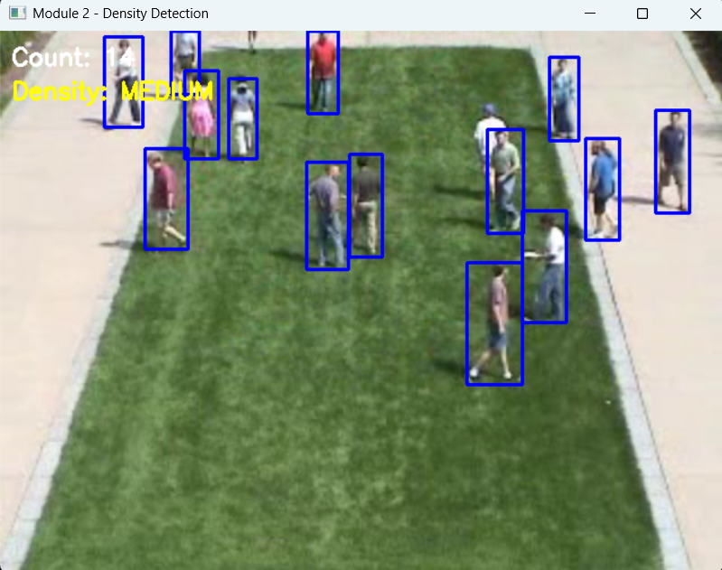
MODULE 2-DENSITY DETECTION

Slide 12
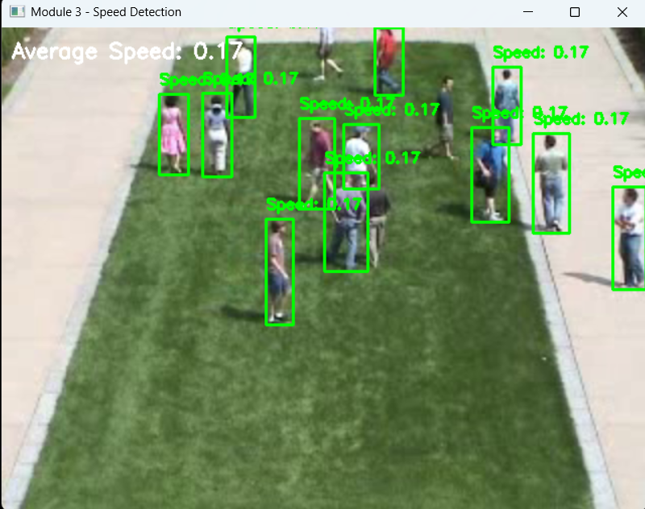
MODULE 3-SPEED DETECTION

Slide 13
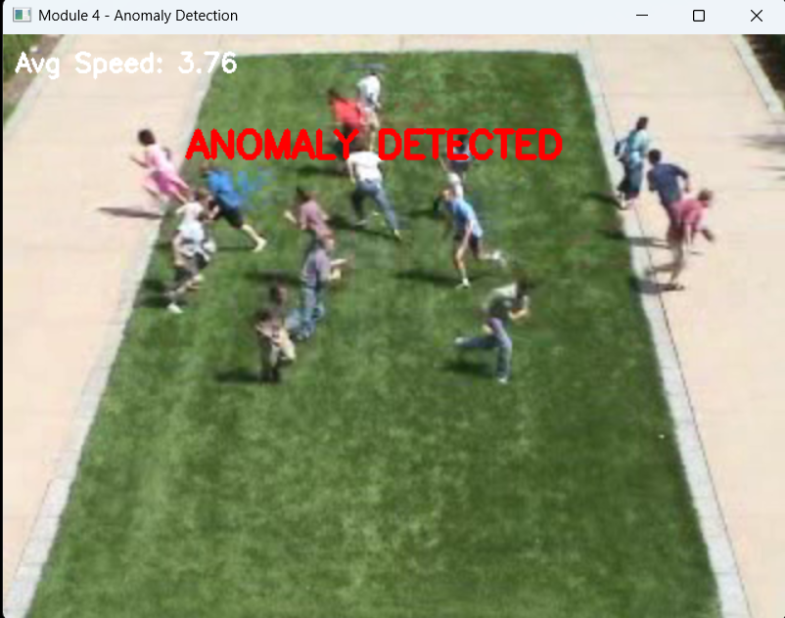
MODULE 4-ANOMOLY DETECTION

Slide 14
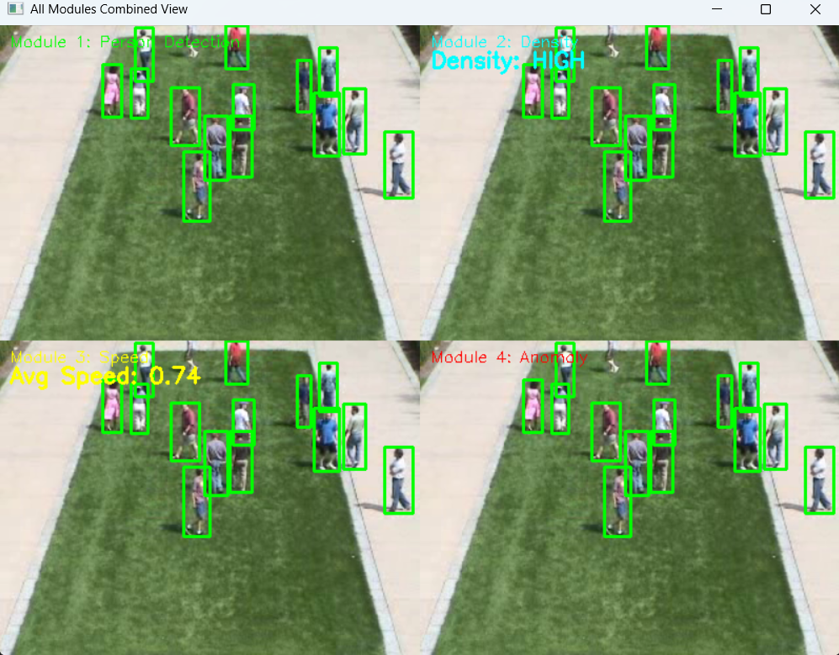
FINAL OUTPUT

Slide 15
CONCLUSION
The proposed Intelligent Real-Time Crowd Dynamics Analysis and Monitoring System effectively integrates computer vision techniques to detect, analyze, and monitor crowd behavior in real time. By combining human detection, density estimation, speed tracking, and flow direction analysis, the system enhances public safety, event management, and urban planning.
Although challenges such as occlusion, lighting variations, and computational complexity exist, optimized models and proper hardware support can significantly improve performance. Overall, the system provides a scalable and intelligent solution for modern surveillance and crowd management applications

Slide 16
REFERENCES
Prakash, B. S., Tamilsudar, B., & Kani, T. V. (2025). AI Enhanced Surveillance for Identifying and Recognizing Crowd Behavior — discusses deep learning architectures (CNNs, RNNs, Transformers) applied in real-time crowd analysis and behavior recognition in video surveillance. IJRASET
Behera, S., Dogra, D. P., Bandyopadhyay, M. K., & Roy, P. P. (2023). Crowd Characterization in Surveillance Videos using Deep-Graph Convolutional Neural Network — a 2023 IEEE article on crowd dynamics modeling and classification from motion patterns. PubMed
Mallick, S. S., Das, I., Das, S., & Karmakar, R. (2024). Intelligent Crowd Density and Motion Direction Estimation for Real-Time Crowd Dynamics — explores YOLOv8 and optical flow for real-time analysis. EurekaMag
Qaraqe, M., Yang, Y. D., Varghese, E. B., Basaran, E., & Elzein, A. (2024). Crowd Behavior Detection: Leveraging Video Swin Transformer for Crowd Size and Violence Level Analysis — advanced transformer-based crowd behavior and violence detection. Springer
Alhawsawi, A. N., Khan, S. D., & Ur Rehman, F. (2024). Crowd Counting in Diverse Environments Using a Deep Routing Mechanism Informed by Crowd Density Levels — addresses crowd counting and varying conditions. MDPI

Slide 17
Thank You!

